Slide 1
Classification of phylum Arthopoda upto class

Slide 2
Phylum Arthropoda is Classified in to 7 classes
Crustacea (Crusta - shell) e.g. Prawn, crab, wood louse
Arachnida (Arachne - spider) e.g. Scorpion, spider, tick, mite
Chilopoda (Chilo - lip; poda - appendage) e.g. Centipedes
Diplopoda (Diplo - two; poda- appendage) e.g. Millipede
Trilobita (an extinct group)
Hexapoda (Hexa- six; poda-legs) or Insecta (In- internal; sect – cut) e.g. Insects

Slide 3
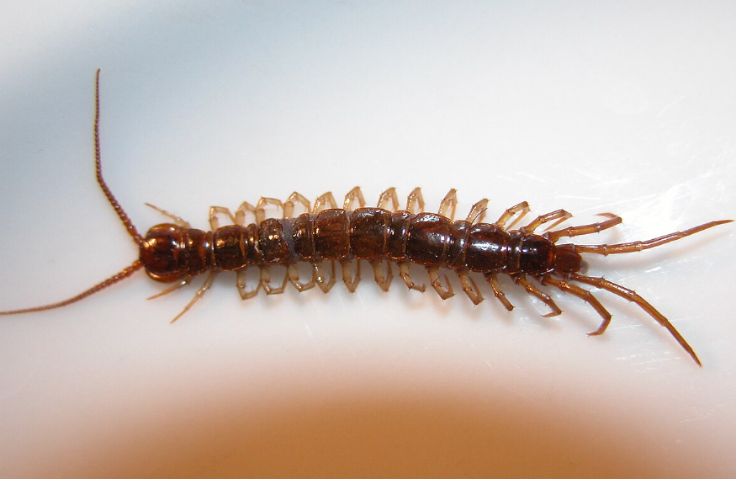
Class: Chilopoda
Chilo - lip; poda - appendage)
Chilopods are quick moving predators with poison glands.
Terrestrial in habitat
body is long, flattened and multi-segmented.
1 pair of legs per body segment.
1 pair of antennae.
1st pair of legs modified into venomous “fangs”
Centipede

Slide 4
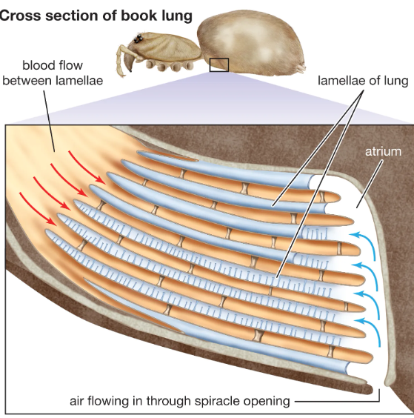
Respiration: Trachea
Development : Direct

Slide 5
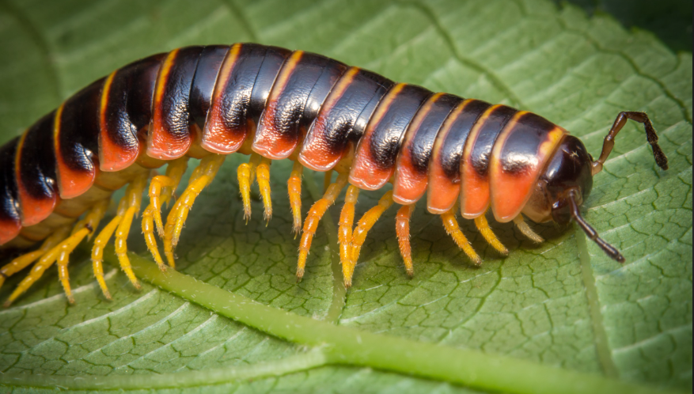
Class: Diplopoda
(Diplo - two; poda- appendage)
Diplopods are slow moving vegetarians.
Single pair of antennae
Many body segments
long and cylindrical
2 pair of legs per body segment
Generally feed on decaying vegetable matters.
E.g.: millipedes, sow bugs, etc.
Milipedes

Slide 6
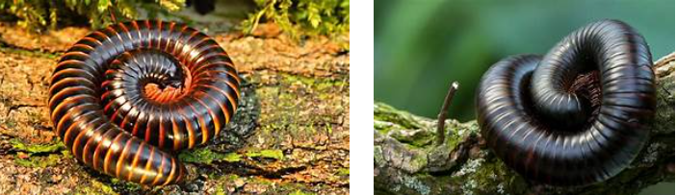

Slide 7
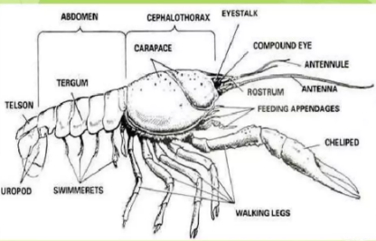
Class: Crustacea
(Crusta - shell)
Mostly aquatic, free-living parasites.
Two body regions – Cephalothorax (head= thorax) and abdomen.
Dorsal exoskeleton carapace.
Pairs of antennae.
Pair of stacked compound eye.
Varied number of legs (usually five).

Slide 8
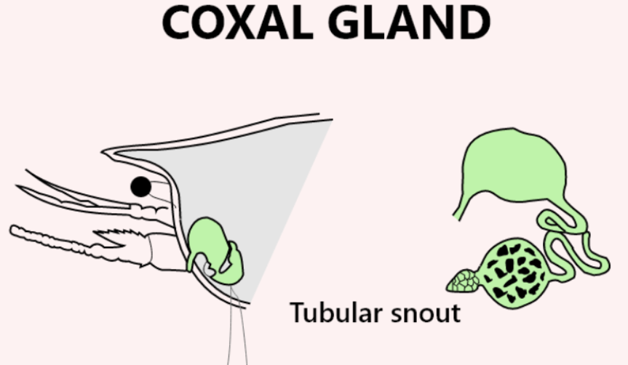
Respiration is done by skin or by gills.
Excretion is done by green glands.
Sexes are usually separate.
Indirect development.
Varied number of legs (usually five) Prawn

Slide 9
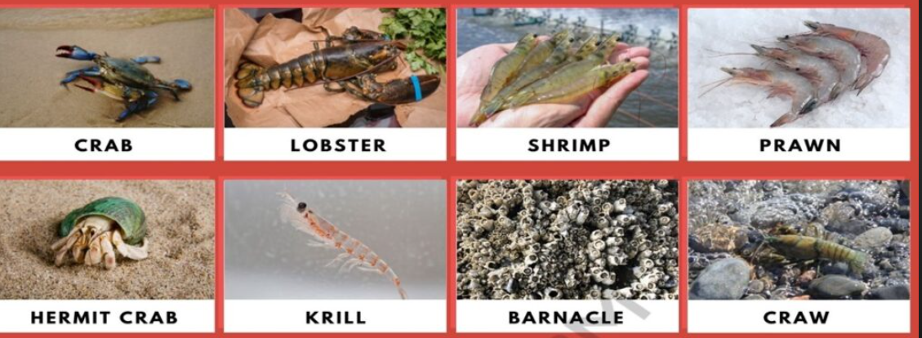

Slide 10
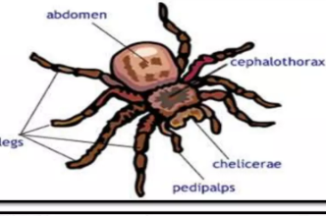
Class: Arachnida
(Arachne – spider like)
Terrestrial
2 body segments - cephalothorax and abdomen.
6 pairs of appandeges (1 pair chelicerae,
1 pair pedipalpi, 4 pair of legs).
Antennae absent.
simple eyes

Slide 11
Respiration is done by trachea or book lungs.
Spiders spin the web by means of a secretion of abdominal gland.
Scorpion, spider, tick, mite etc.
Excretory organ : Coxal gland

Slide 12
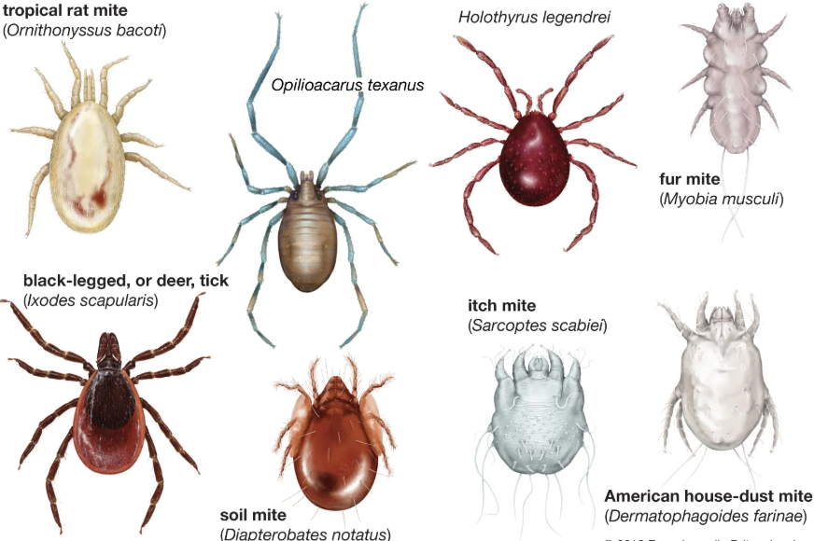

Slide 13
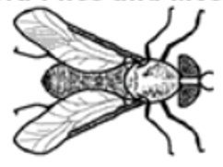
Class: Insecta (Hexapoda)
Body divided in to 3 segments: head, thorax and abdomen.
Possess three pairs of legs, hence the name Hexapoda.
Presence of one or two pairs of wings.
A pair of antennae.
Respiration by means of internal air tubes known as trachea.
Genital opening situated at the posterior end of the body.
Presence of metamorphosis (incomplete/complete) during development.
Possess exoskeleton made up of hard cuticle which plays important role for survival.
Excretion is mainly by malpighian tubules which help in maintaining ionic balance

Slide 14
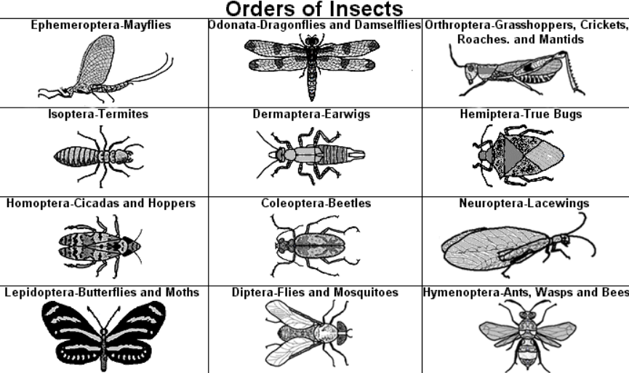

Slide 15
Insect Morphology

Slide 16
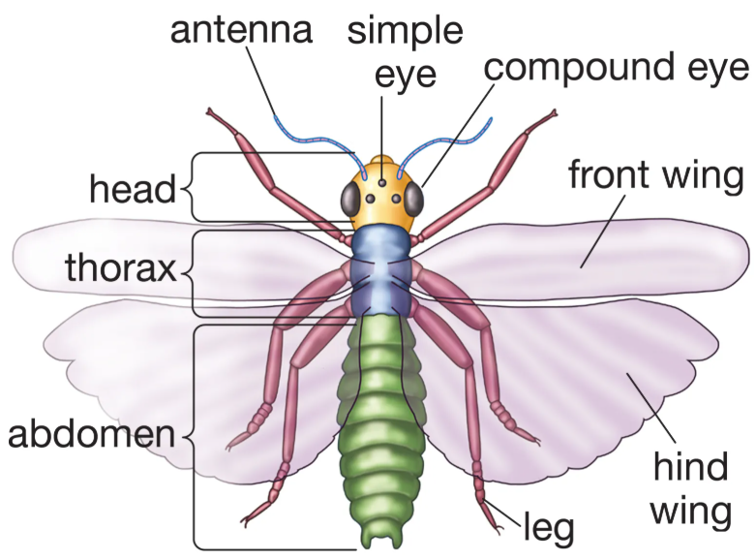
General Body Plan of Insects
Body Segmentation: The insect body is divided
into three main regions
1. Head – for sensing and feeding
2. Thorax – for locomotion (wings and legs)
3. Abdomen – for digestion, reproduction,
and excretion

Slide 17
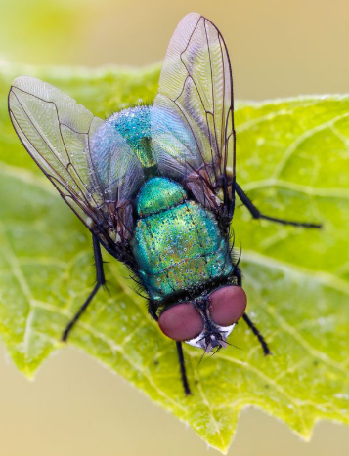
1. Head
Composed of 6 fused segments.
Carries important sense organs:
2. Antennae
Sensory (smell, touch, temperature, vibration).
3.Eyes
Compound eyes (many ommatidia, form a mosaic image).
Ocelli (simple eyes, detect light intensity).

Slide 18
Thorax
Made of 3 segments:
Prothorax – 1st pair of legs
Mesothorax – 2nd pair of legs + 1st pair of wings
Metathorax – 3rd pair of legs + 2nd pair of wings
Legs: 3 pairs (adapted for walking, jumping, swimming, digging, grasping).
Wings: Usually 2 pairs, sometimes reduced or absent (e.g., flies with halteres).

Slide 19
Abdomen
Usually 11 segments (often reduced).
Spiracles – openings for respiration.
Genital organs – male (aedeagus) and female (ovipositor).
Cerci – paired appendages for sensing or defense (in some insects).

Slide 20
Other Important Features
Exoskeleton: Made of chitin (light but strong, provides protection).
Respiration: Via tracheal system (network of tubes connected to spiracles).
Circulation: Open circulatory system* (hemolymph instead of blood).
Nervous system: Brain + ventral nerve cord with ganglia.
Reproduction: Mostly sexual, with great diversity in egg laying and development.

Slide 21
Metamorphism in insects
Insects are arthropods that grow by molting (shedding their exoskeleton). Their development pattern is called metamorphosis.
Depending on how much their body form changes from young to adult, insects show three main types of life cycles:

Slide 22
1. Ametabolous Development (No Metamorphosis)
Stages: Egg → Young (immature) → Adult
Features:
Newly hatched insect looks like a miniature adult.
Only difference is smaller size and sexual immaturity.
No wings.
They grow through a series of molts until maturity.
Examples: Silverfish (Lepisma), Springtails (Collembola).

Slide 23
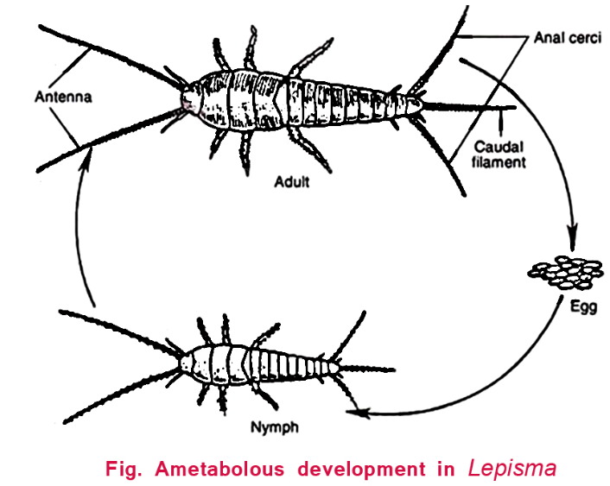

Slide 24
2. Hemimetabolous Development (Incomplete/partial Metamorphosis)
Stages: Egg → Nymph → Adult
Features:
Nymph resembles adult but is smaller, wingless, and lacks reproductive organs.
With every molt, nymph grows bigger and gradually develops wing pads.
Final molt produces an adult with functional wings and reproductive organs.
There is no pupal stage.
Examples: Grasshoppers, Cockroaches, Termites, Dragonflies.

Slide 25
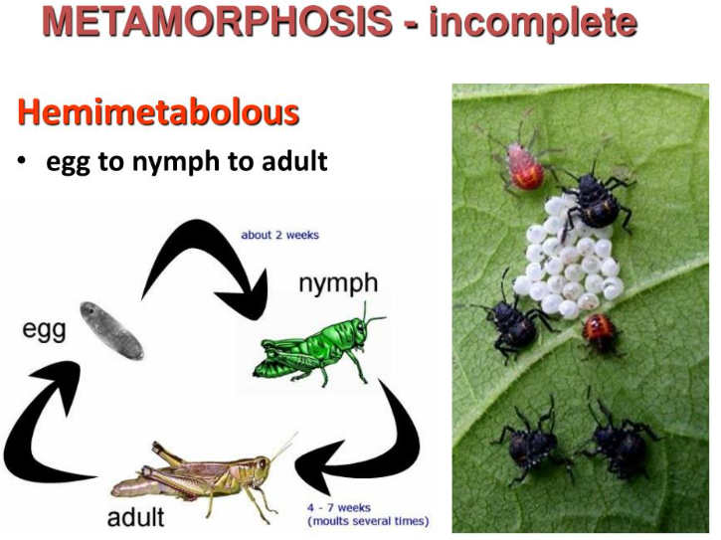

Slide 26
3. Holometabolous Development (Complete Metamorphosis)
Stages: Egg → Larva → Pupa → Adult
Features:
Larva: Looks completely different from adult, soft-bodied, specialized for feeding (e.g., caterpillar, grub, maggot).
Pupa: Resting/non-feeding stage. Inside, tissues break down and reorganize (histogenesis) to form adult structures. Examples: cocoon of silkworm, chrysalis of butterfly.
Adult: Reproductive and usually winged stage.
Larvae and adults live in different habitats and eat different foods → avoids competition.
Examples: Butterflies, Houseflies, Mosquitoes, Beetles, Bees, Ants.

Slide 27
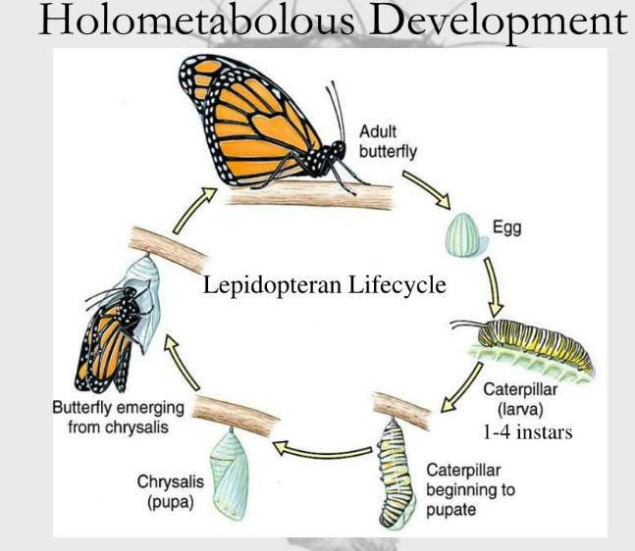

Slide 28
Blow Fly

Slide 29
Kingdom: Animalia Phylum: Arthropoda Class: Insecta Order: Diptera (true flies – two wings) Family: Calliphoridae (blow flies) Genus: Calliphora / Lucilia / Chrysomya (different genera of blow flies) Species: Examples – Calliphora vicina (bluebottle fly), Lucilia sericata (greenbottle fly), Chrysomya megacephala (oriental latrine fly).

Slide 30
Blow flies (Family: Calliphoridae) are among the most important insects in forensic entomology because they are usually the first to colonize a dead body and help in estimating the postmortem interval (PMI).

Slide 31
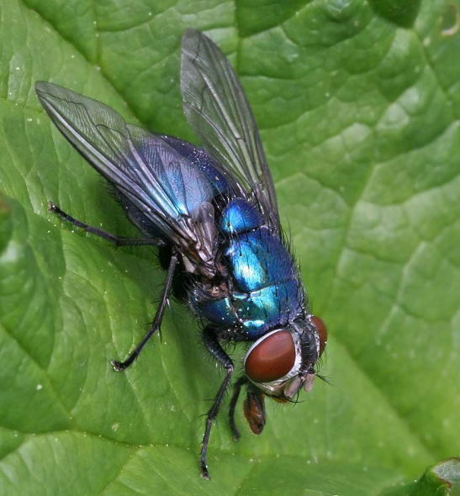
Size: Medium-sized, usually 6–14 mm long.
Color: Distinctive metallic sheen – blue, green, bronze, or black depending on the species.
Body: Robust and bristly.
Head:Large, reddish-brown compound eyes.
Antennae with arista (bristle-like structure)

Slide 32
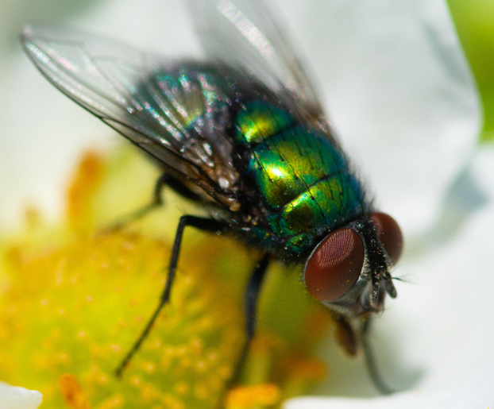
Wings: Clear, with strong veins; when at rest, wings overlap slightly.
Mouthparts: Sponging type, adapted for feeding on liquids, blood, and decomposing matter.
Larvae (maggots): Creamy-white, legless, cylindrical with tapered ends; posterior
spiracles useful for species identification.

Slide 33
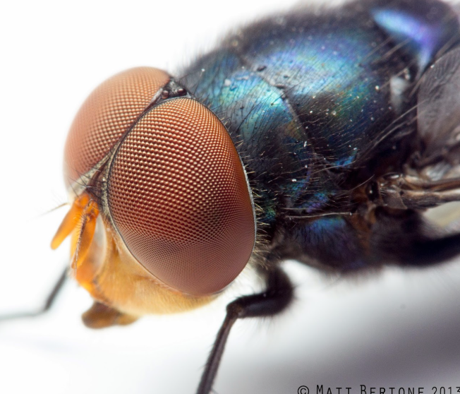
Metallic Body Coloration – bluish-green, shiny, which gives them the common name “bluebottles” or “greenbottles.”
Strong Fliers – attracted to carcasses, wounds, garbage, and decaying organic matter.
Egg Laying – females lay clusters of hundreds of white eggs on fresh remains or wounds.
Ecological Role – primary colonizers of carrion, assisting in decomposition.

Slide 34
Behavior – often noisy in flight, commonly seen buzzing near carcasses, garbage bins, or wounds of animals and humans.
Species Diversity – important forensic genera include:
Lucilia (green bottle flies)
Calliphora (blue bottle flies)
Chrysomya (common in warmer regions)

Slide 35
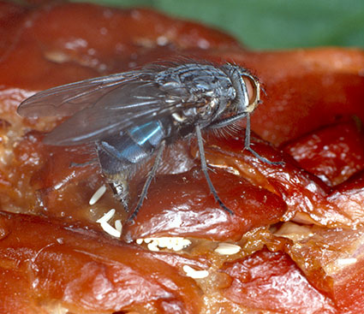
Life Cycle of Blow Fly
Egg Stage
Appearance: White, elongate, about 1–2 mm long.
Location: Laid in moist, protein-rich areas such as natural body orifices (nose, ears, mouth, eyes, genitals) or open wounds.
Quantity: Female lays 200–300 eggs per batch; several batches during her lifetime.
Duration: 8–24 hours (hatch depending on temperature).

Slide 37
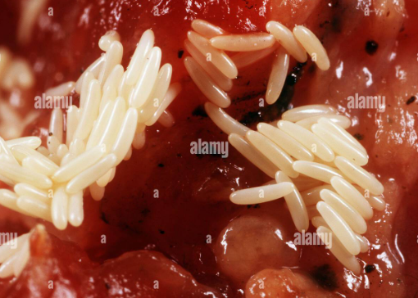

Slide 38
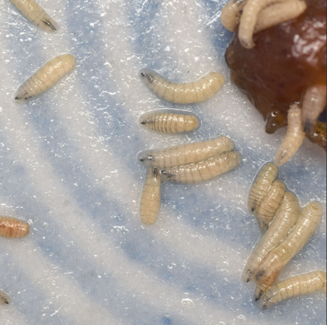
Larval Stage (Maggots)
The larva passes through 3 instars (growth stages).
Appearance: Legless, conical, creamy-white.
Feeding: Actively feed on decomposing tissues.
Breathing: Through posterior spiracles (useful for species identification).

Slide 39
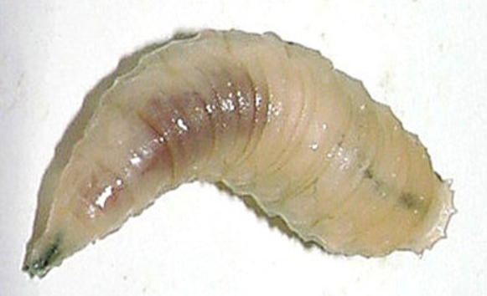

Slide 40
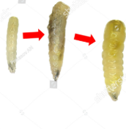
Instars:
First Instar
Size: ~5mm.
Duration: ~1.8 days.
Weak feeders, found near egg-laying site.
Second Instar
Size: ~10 mm.
Duration: 2.5 days
Stronger mouth hooks, more aggressive feeding.
Third Instar
Size: up to 14-16 mm.
Duration: 4-5 days.
Voracious feeders; at the end, they migrate away from the body to pupate.

Slide 41
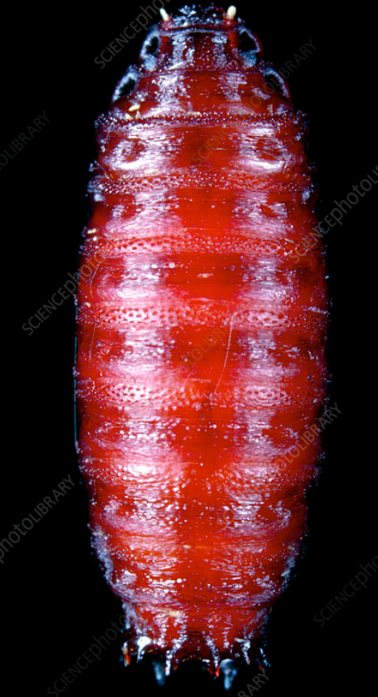
Pupal Stage
Appearance: Hard, brown, capsule-like (puparium).
Location: Usually buried in soil, leaf litter, or concealed near the body.
Duration: 3–7 days (varies with environment).
Transformation into the adult occurs inside the puparium.

Slide 42
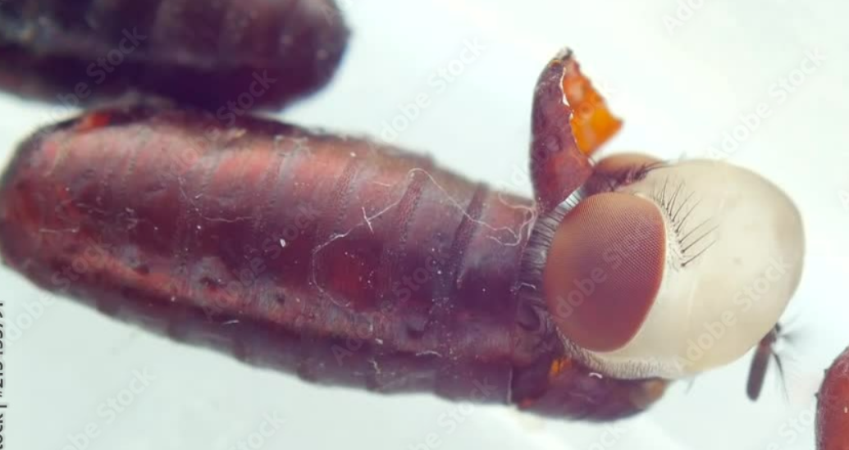

Slide 43
Adult Stage
Emergence: Fully developed fly emerges from the puparium.
Appearance: Metallic (green, blue, or bronze depending on species).
Life Span: 2–3 weeks (sometimes longer).
Reproduction: Mating occurs within a few days; females begin egg-laying soon after.

Slide 44
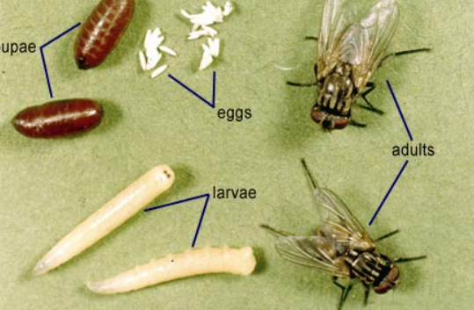

Slide 45
